Slide 1



Molecular Electronics: Octadecyltrichlorosilane Self-Assembled Monolayers on Silicon Dioxide
Gisselle Gonzalez¹, Adam Hinckley², Anthony Muscat²
¹Department of Biomedical Engineering, The University of Arizona, Tucson, AZ ²Department of Chemical Engineering, The University of Arizona, Tucson, AZ
NASA Space Grant Symposium
Tucson, AZ
April 14, 2018

Slide 2
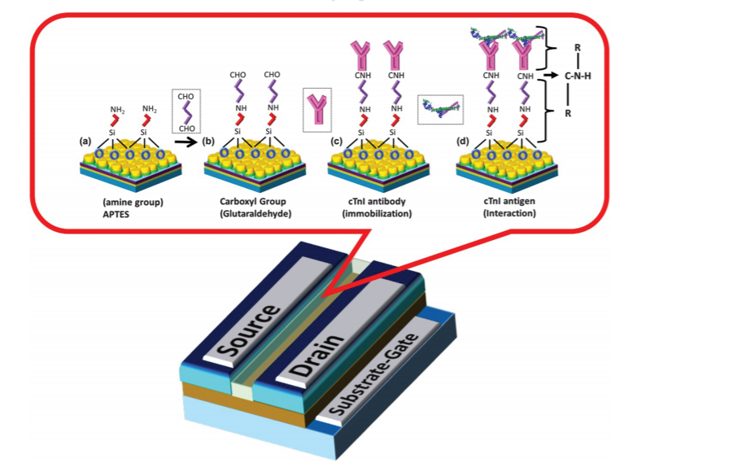
Molecular Electronics in Biosensing Applications
Molecular electronics relies on a “bottom-up” fabrication method [1].
Patterning surfaces for molecular electronics provides higher surface area and signal output.
Arshad et al. demonstrated that titanium oxide (TiO₂) can be deposited into patterns to detect cardiac troponin.

Slide 3

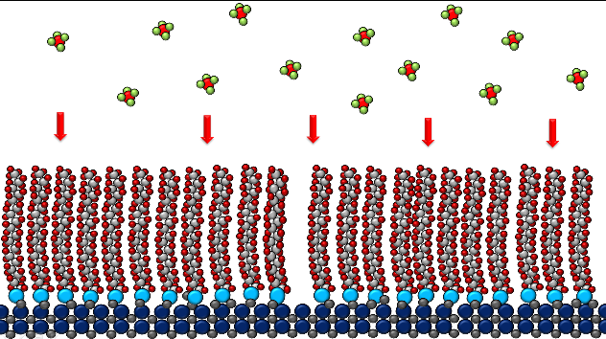
Self-Assembled Monolayers (SAMs)
Octadecyltrichlorosilane (OTS)
Organic layers deposited or patterned on surfaces at nanometer scale.
Chemically adsorb (chemisorb) "head groups" on surface.
“Tails” point away from surface.
Hydrocarbon Tail
Head Group:
Trichlorosilane
(Cl₃-Si-O)
3

Slide 4
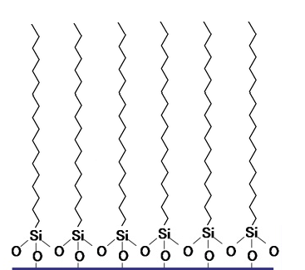
Hypotheses
Cl
Cl
Ti
Cl
Cl
1. OTS SAMs deposited onto silicon dioxide (SiO₂/Si ) will prevent titanium chloride (TiCl₄) adsorption.
2. OTS SAMs can be patterned to create titanium oxide (TiO₂) based sensors.
OTS deposited onto surface
Grid pattern
4

Slide 5
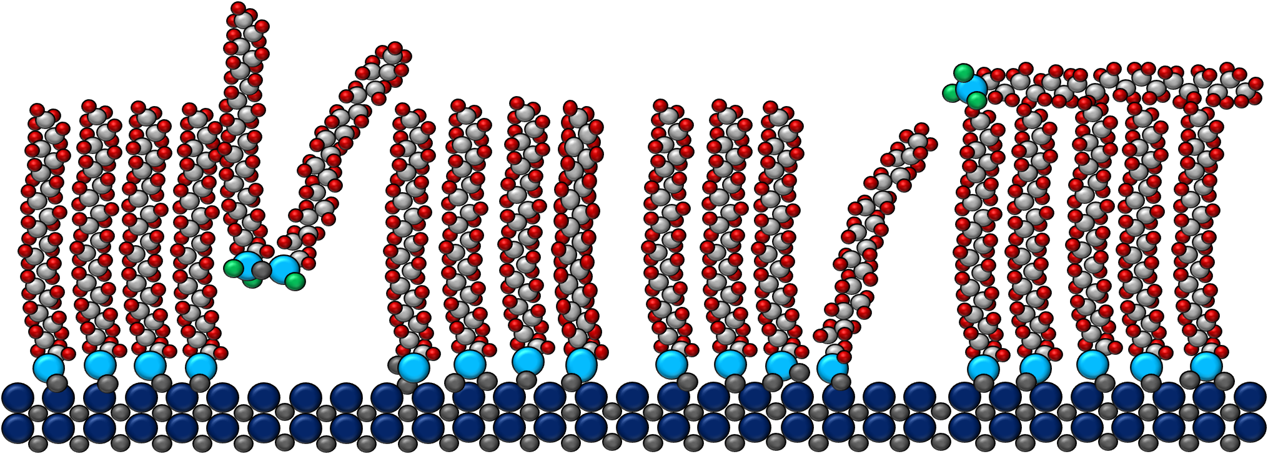
OTS Deposition Procedure
OH
OH
OH
OH
OH
Samples cleaned
  Sonicated in acetone and methanol
  Dilute nitric acid (70%, 1:3 by volume) treatment
    80º C, 10 minutes
24 hr. OTS deposition
  Room temperature
Correct defects
  Samples sonicated in chloroform, 2 minutes
  SC-1 (5:1:1) Treatment
    H₂O, NH₄OH, H₂O₂
24 hr. OTS deposition
  Room temperature
  Samples sonicated in chloroform
SiO₂
Si
OTS
SiO₂
Si
5

Slide 6
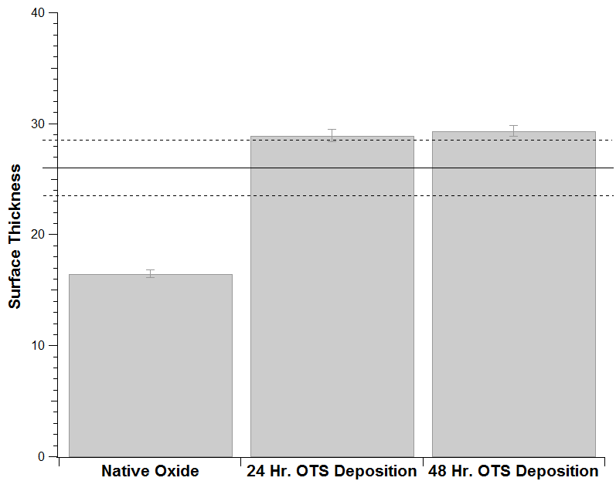
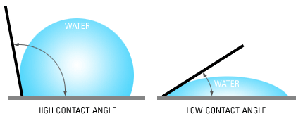

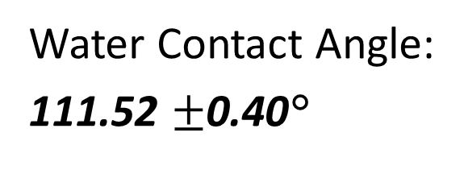
Results: OTS deposition on SiO₂/Si in ambient forms a SAM of 29$±$0.50 Å
(Å )
Water Contact Angle:
111.52 $±$0.40°
Ellipsometry data showing thickness of native oxide and OTS SAM (95% confidence intervals)
6

Slide 7
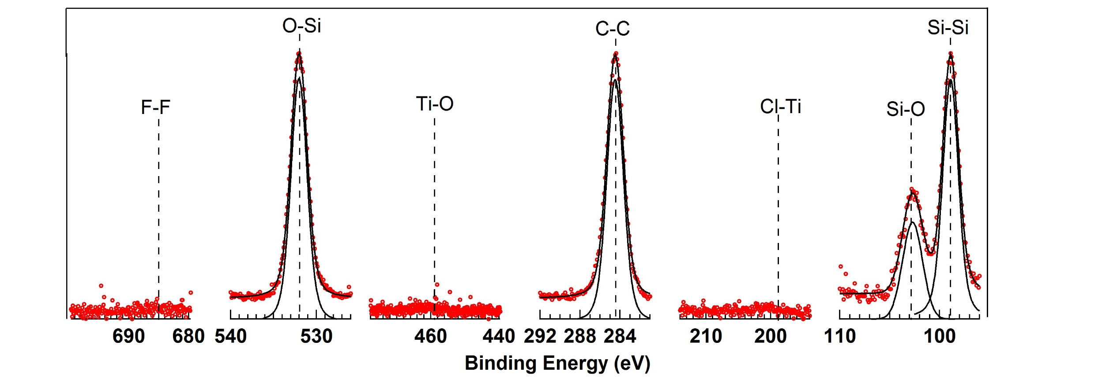
OTS SAMs deactivated surface for up to 200 pulses of TiCl₄
XPS spectrum after 200 pulses (200 ms and 0.2 sccm) of TiCl₄
7

Slide 8
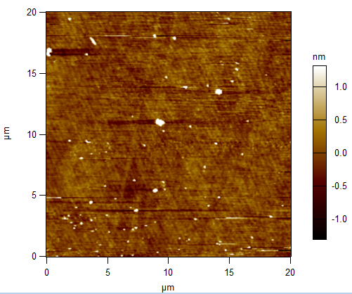
Atomic force microscopy shows OTS monolayer roughness of 0.2 nm
Atomic force microscopy (AFM) further shows defect free surface.
Surface roughness is equal to untreated SiO₂ surface .
Ra: 0.2 nm
Surface roughness calculated from AFM:
Rq: 0.4 nm
Ra: 0.2 nm

Slide 9
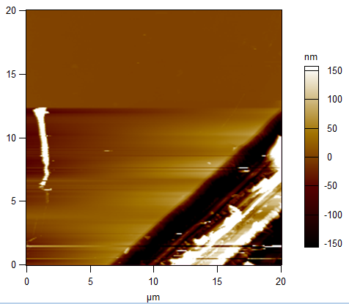
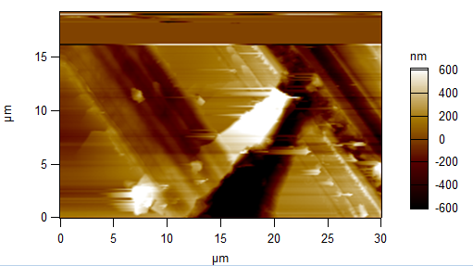
Scoring OTS is example of SAM patterning
OTS manually scored using a diamond scribe
Contact mode AFM confirmed OTS removal
Scored surface
Rq: 77.575 nm
Ra: 38.465 nm
Rq: 309.007 nm
Ra: 202.237 nm

Slide 10
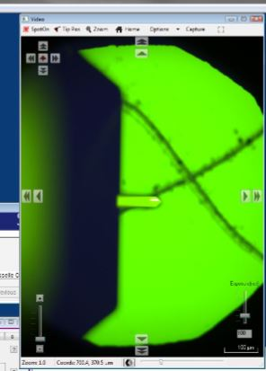
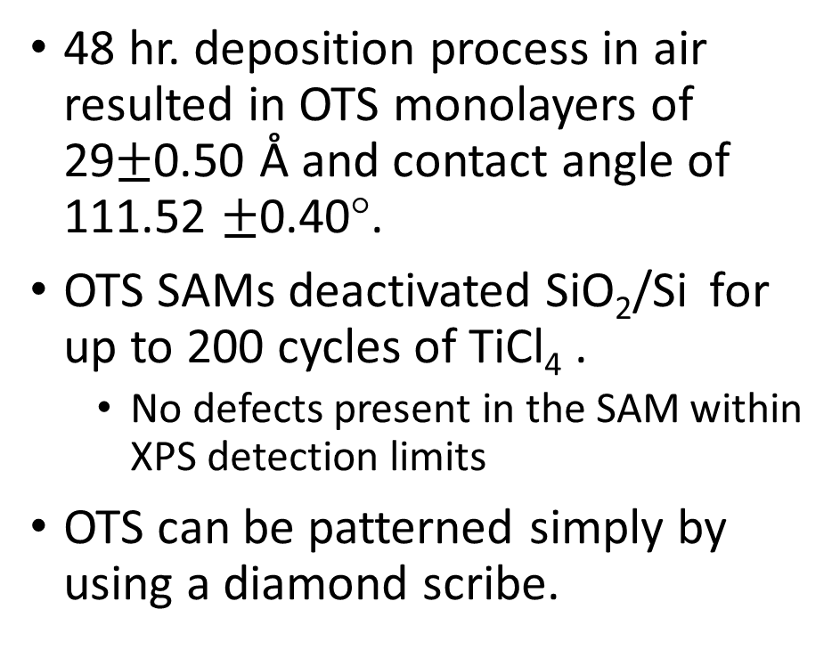
Conclusion
48 hr. deposition process in air resulted in OTS monolayers of 29$±$0.50 Å and contact angle of 111.52 $±$0.40°.
OTS SAMs deactivated SiO₂/Si for up to 200 cycles of TiCl₄ .
  No defects present in the SAM within XPS detection limits
OTS can be patterned simply by using a diamond scribe.
Optical image of AFM cantilever and scored surface

Slide 11
Future Work
Use UV light and conductive AFM to make nanoscale patters.
Deposit TiO₂ onto patterns for sensors.
Grid pattern
Mushroom pattern

Slide 12

Acknowledgements
Dr. Anthony Muscat’s Research Group

Slide 13
References
Arshad, M. K. Md, et al. “Field-Effect Transistor-Integration with TiO2 Nanoparticles for Sensing of Cardiac Troponin I Biomarker.” Journal of Nanoscience and Nanotechnology, vol. 18, no. 8, 2018, pp. 5283–5291., doi:10.1166/jnn.2018.15419.
B. A. Mantooth and P. S. Weiss, "Fabrication, assembly, and characterization of molecular electronic components," in Proceedings of the IEEE, vol. 91, no. 11, pp. 1785-1802, Nov 2003.
doi: 10.1109/JPROC.2003.818320

